Slide 1

AI-Driven Adaptive Physical Testing for Embedded Systems
UN Sustainable Development Goal - 9
Industry, Innovation & Infrastructure
Team 29 | Chip Tech | EL Phase II | 13 November 2026

Slide 2


Chip Tech
Kavin Krishnan C
1RV24CS126
Chinmai Kiran Shetti
1RV24CS068
Sumukha Upadhyaya
1RV24IS130
MENTOR
Dr. H K Krishappa
Snehal Reddy Thadigotla
1RV24IS126
Sutej R Haritsa
1RV24CY055

Slide 3
Introduction
Background
Embedded systems can experience failures under specific combinations of voltage levels, workloads, peripheral states, and event timings. Exhaustively testing every possible combination is impractical, making efficient and reliable testing essential.
Proposed Solution
The Adaptive Hardware Fuzzing Testbench (AHFT) proposes a safety-constrained testing framework that learns from previous hardware experiments to select subsequent tests intelligently. It aims to discover, reproduce, and minimize system-level failures while operating within predefined safety limits.

Slide 4

Introduction
Problem based learning
This project follows a problem-based learning approach by addressing the real-world challenge of inefficient embedded-system testing, requiring us to investigate existing methods, identify their limitations, and develop and evaluate an adaptive, safety-constrained solution through experimentation.
SDG Alignment
SDG 9 — Industry, Innovation and Infrastructure
Target 9.5: Supports technological innovation and research through adaptive hardware-testing methods.
Sustainability principles: Reliability, resilience, and efficient use of testing resources.

Slide 5
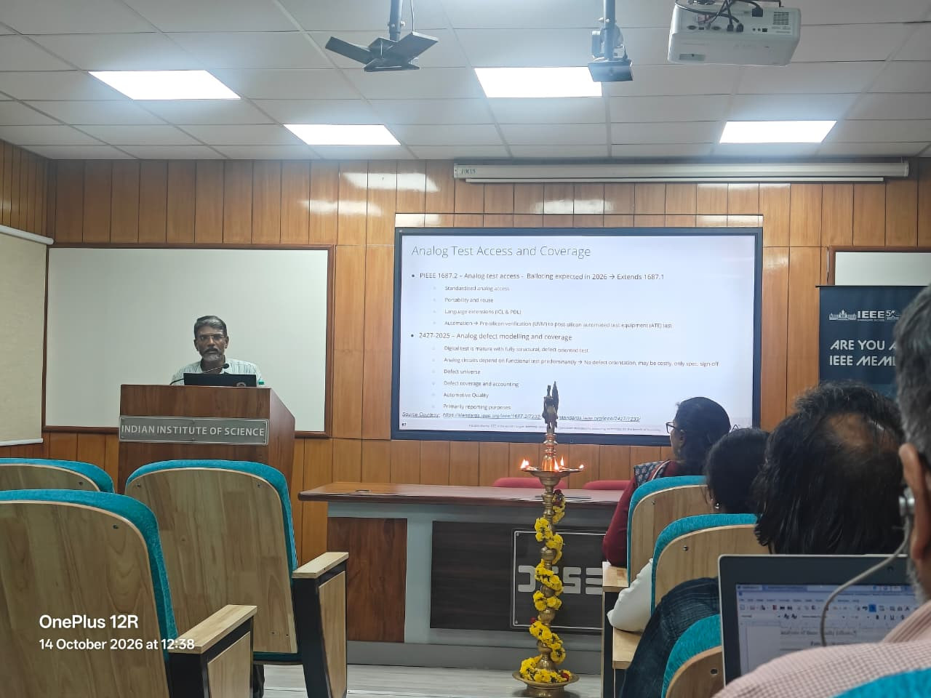
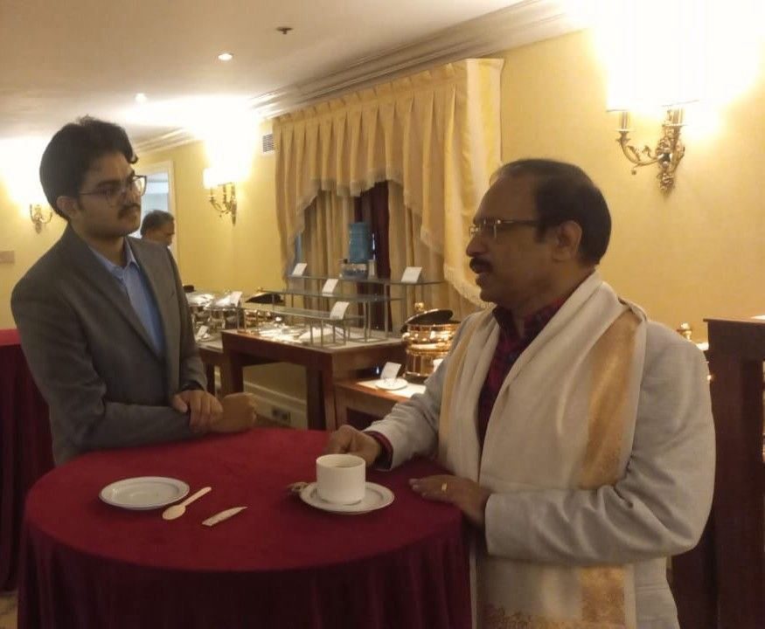
Industry Interaction
https://docs.google.com/spreadsheets/d/1XoIdEJ94GM5O8eeq7zOlil-07-r5dy2Zr2UhShgsFCg/edit?usp=sharing
14th October, 2026 - IEEE World Standards Day @IISc, Bengaluru
-> Could Interact with Mr. Lakshmanan Balasubramanian, Texas Instruments
Maxon India Event @Windsor manor
Dr.Ashokan T, Mechanical Prof IITM

Slide 6
Problem Definition
EL Phase-II | Project Execution
Project Objective
To develop and evaluate a safety-constrained adaptive testing engine that uses/learns from the previous experimental results to select informative hardware tests, discover failures using fewer experiments, and identify the minimal conditions required to trigger them.
Research Question: Can adaptive, feedback-driven testing discover and minimize embedded-system failures more efficiently than conventional testing approaches without executing tests outside the permitted safety envelope?

Slide 7
Objectives
EL Phase-II | Project Execution
Develop an adaptive testbench to find embedded-system failures within defined safety limits and a fixed experiment budget.
Specific Objectives:
Build a testbench setup with controlled voltages and workloads.
Use TPE (Tree-structured Parzen Estimator) to select tests from previous results.
Detect, reproduce and minimize failures using measured behaviour.
Compare failure discovery against Random and Grid Search.
Expected Contribution: A reproducible testbench and evidence on whether adaptive search finds failures in fewer physical experiments.
Referencing to IEEE 1804 2017, continuing to add on/ optimize to analog fuzzing [https://standards.ieee.org/ieee/1804/4604/]

Slide 8
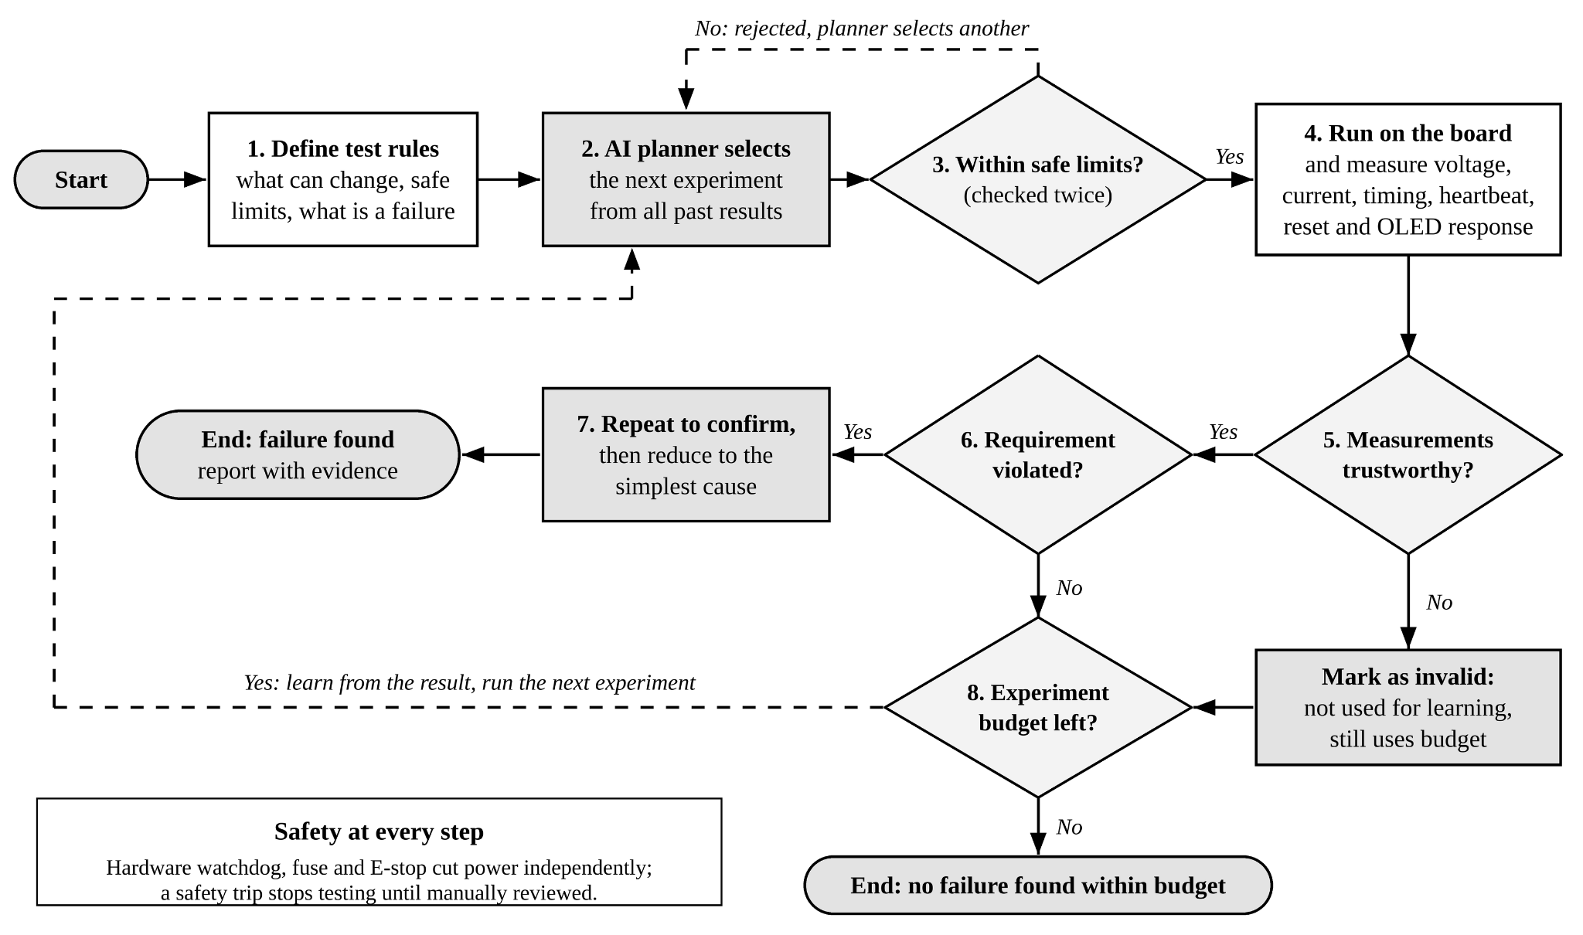
EL Phase-II | Project Execution
Methodology - Proposed methodology

Slide 9
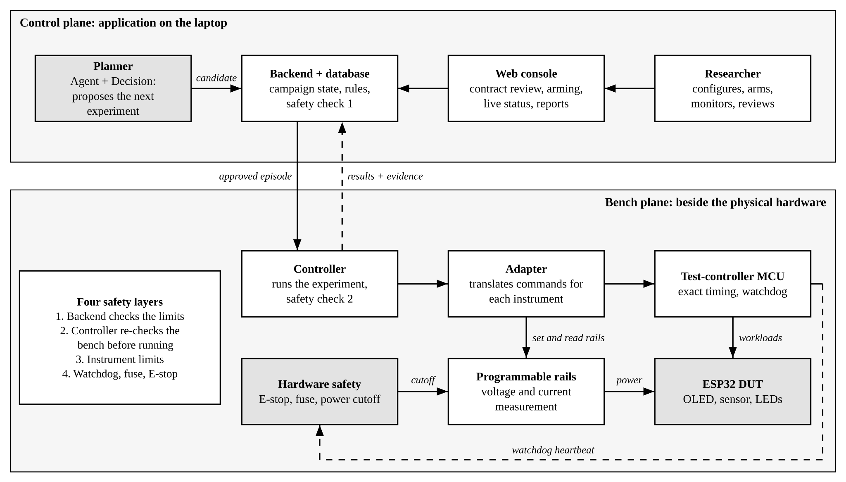
EL Phase-II | Project Execution
Methodology - ystem Architecture

Slide 10
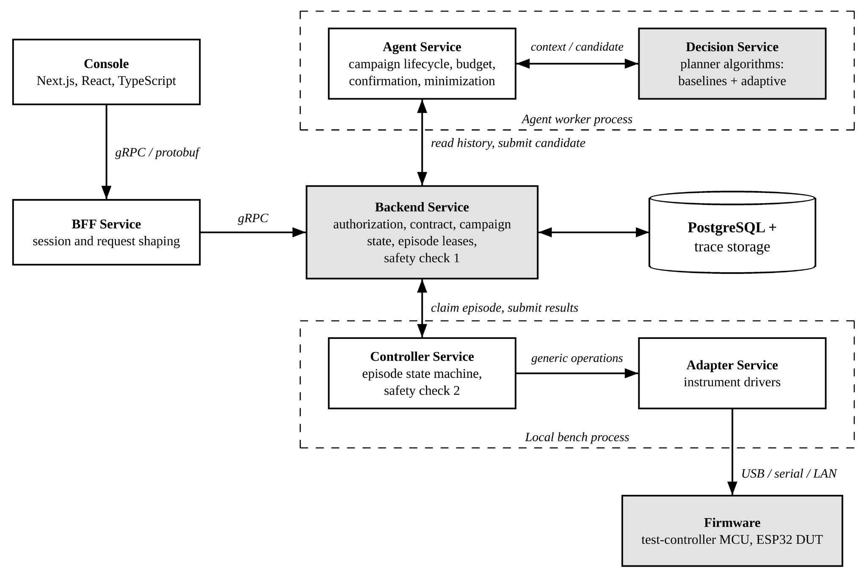
EL Phase-II | Project Execution
Methodology - Microservice Architecture

Slide 11
Methodology - Algorithm
EL Phase-II | Project Execution
Search Space Definition: Define voltage ranges, LED states, and firmware workloads in a test contract.
Initial Exploration: Use random trials to collect initial observations across different configurations.
Adaptive Search: Apply the TPE algorithm to prioritize configurations associated with lower robustness scores.
Safety Validation: Validate every proposed configuration against predefined operating limits using a deterministic safety kernel.
Hardware Execution: Execute approved experiments on the ESP32-S3 using the RP2040 controller.
Failure Detection: Evaluate telemetry against requirements and calculate robustness scores.
Failure Minimization: Replay failures and remove unnecessary conditions.
Performance Evaluation: Compare TPE against Random Search and Grid Search using simulation and physical experiments.

Slide 12
Working - Algorithm
EL Phase-II | Project Execution
Trial Classification: The algorithm separates previous experiments into good and bad groups based on their robustness scores, prioritizing configurations with lower scores.
Probability Modeling: It estimates probability distributions (l(x)) and (g(x)) for good and bad configurations, using Parzen estimators to model promising parameter values and combinations.
Adaptive Sampling: TPE selects new configurations that maximize the ratio \(l(x)/g(x)\), favouring promising candidates. Results from each experiment update the distributions, improving subsequent searches.

Slide 13
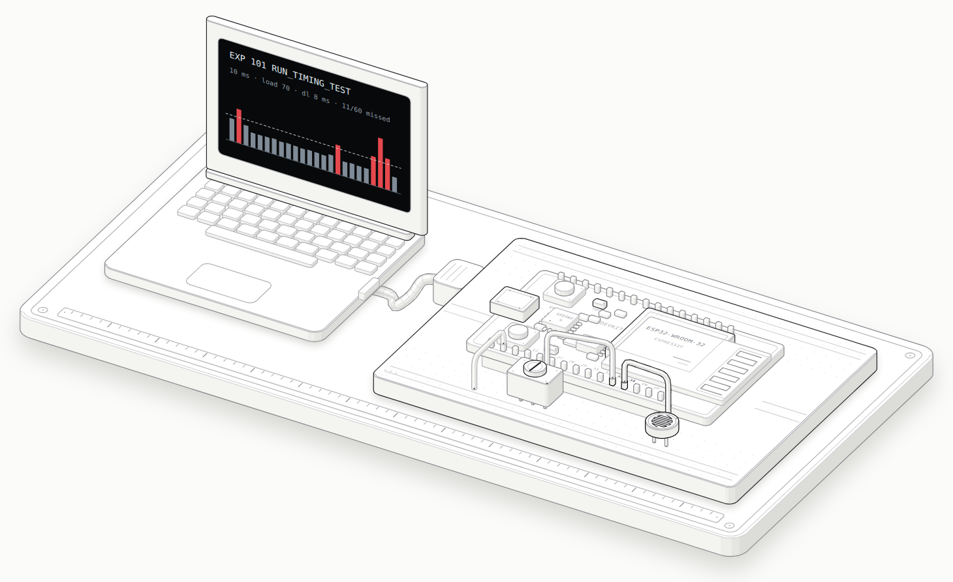
EL Phase-II | Project Execution
Test Bench Hardware
Version 1 setup
ESP32-WROOM-32 DevKit (30-pin), module to be confirmed by the hardware team
LDR on GPIO34, trimmer on GPIO35; 12-bit ADC, raw 0 to 4095
Micro-USB link to the laptop, JSON Lines at 115 200 baud
Synthetic workload sized in calibrated work units (task_load)
No voltages changed and no external loads driven: no hazard beyond USB-powered bench work
Long-term multi-rail rig
ESP32-S3 device, RP2040 test controller, three programmable extra-low-voltage rails, E-stop and fuse
Isometric model of the bench: laptop, USB cable, ESP32 DevKit on a breadboard, LDR (GPIO34), trimmer (GPIO35)
Notes:
The figure is a rendered model built from the bench design, not a photograph.

Slide 14
EL Phase-II | Project Execution
Experiment Contract and Protocol
Variable | Range | Meaning
sampling_interval_ms | 5 to 1000 ms | Period between task releases
duration_ms | 100 to 30 000 ms | Measured window
sensor_type | LDR, POT, ADC_SIM | Sensor read in each task
task_load | 0 to 100 units | Calibrated synthetic work
deadline_ms | 2 to 1000 ms | Deadline from scheduled release
warmup_ms | 0 to 5000 ms | Excluded from all statistics
Wire format (UTF-8 JSON Lines)
{"command":"EXECUTE","experiment_id":42,
"sampling_interval_ms":10,"duration_ms":1000,
"sensor_type":"POT","task_load":70,
"deadline_ms":8,"warmup_ms":100}
{"type":"SAMPLE","experiment_id":42,
"sequence_number":1,
"scheduled_time_us":10000,
"actual_time_us":10120,
"execution_time_us":9340,
"sensor_value":2048,"read_success":true,
"is_warmup":true}
Rules enforced on both PC and device
Integers only for integer fields (no booleans, floats or strings)
All problems of a bad request returned together; nothing is clamped
At most 4096 samples per experiment; duration at least one interval
Commands: PING, GET_CAPABILITIES, EXECUTE, STOP
Deadline rule (frozen): a sample misses if completion time exceeds scheduled time plus deadline.
Both start lateness and execution time count.

Slide 15
EL Phase-II | Project Execution
Project Plan and Execution Status
Phase I
Initiation
Weeks 1-2
Phase II
Planning and design
Weeks 3-4
Phase III
Safe control and firmware
Weeks 5-8
Phase IV
Adaptive integration
Weeks 9-10
Phase V
Safety acceptance and evaluation
Weeks 11-12
Phase VI
Documentation
Week 13
Green: complete Amber: in progress White: planned. Gates: week 4 (controllable setup or pivot to simulation), week 8 (100 nominal episodes, under 5% invalid), week 12 (zero unsafe executions).
Component | Status | Evidence
Test contract, validation, two-layer safety check | Done (software) | Rejection paths unit tested
Backend, Controller, simulator, campaign loop | Done (simulation) | Console demo, 4 finished campaigns
Planners: random, grid, coverage, TPE (+ optional GP) | Done (simulation) | Benchmark, 20 campaigns per cell
Console: campaigns, contracts, fixtures, results, compare | Done | Screenshots in Partial Results
ESP32 timing pipeline (JSONL, oracle, ExtraTrees) | Specified, integration in progress | PRD Part II; browser verification pending
Real ESP32 bring-up and hardware campaigns | Not started | Gate: bring-up checklist steps 1 to 13
Notes:
Phase durations follow the Phase-1 timeline (13 weeks). Status reflects the repository and PRD as of 13 November 2026.

Slide 16
EL Phase-II | Tools and Techniques
Backend Services and Storage
Tools and Technologies
Python 3.12 with uv: runs the Backend, Agent, Decision, Oracle, Controller and Adapter services as a control-plane and a bench process.
SQLite and trace files: store runs, raw samples, summaries and the append-only audit log for every campaign.
NumPy, Optuna, optional PyTorch: implement the random, grid, coverage and TPE planners and the optional GP model.
Techniques
Contract-based validation: every candidate is checked against the approved test contract (ranges, integers only, nothing clamped) before it can run.
Two-layer safety check: the Backend and the Controller apply the same shared safety-rule library; the Controller re-checks against live bench state.
Append-only audit trail: decisions, rejections and operator actions are logged so any result can be replayed and explained.
Seeded, deterministic runs: the same seed, budget and oracle are used for every planner so comparisons are fair.
Model and decision layers import no bench code; the Controller is the only component that touches hardware.

Slide 17
EL Phase-II | Tools and Techniques
Research Console
Tools and Technologies
Next.js 15 and React 19: operator Console for campaigns, contracts, fixtures, results and compare views.
TypeScript with tsc: type-checked UI; server routes act as the only path to the Backend and keep the operator token out of the browser.
Headless Chrome and Playwright: capture repeatable screenshots of every Console state for reports and regression checks.
Techniques
Arming checklist gate: a campaign cannot start until contract, fixture, budget, bench health and E-stop checks all pass.
Live monitoring: budget progress, current episode, bench health, E-stop and watchdog state are polled and shown during a run.
Outcome timeline: passes, failures and verification episodes are plotted in order, so the search path can be inspected.
Compare with censoring: planners are compared on episodes to first confirmed failure, censored at the budget.

Slide 18
EL Phase-II | Tools and Techniques
Technique: Adaptive Test Selection
TPE (Tree-structured Parzen Estimator)
ExtraTrees acquisition (timing feature)
Split past trials into good and bad groups by robustness score
Model two densities l(x) and g(x) with Parzen estimators
Pick the candidate that maximises l(x) / g(x)
Update after every result; random warm start first
A(x) = a . P(fail | x) + b . U(x) + g . Novelty(x)
defaults a = 0.50, b = 0.30, g = 0.20; each term min-max normalised
25 extremely randomised trees; P = mean, U = spread of the trees
Inputs: the six pre-execution variables only (no leakage)
Warm start until 4 labelled experiments exist
Ablations remove P, U or Novelty to test each term
Baselines on the same loop and budget
After a failure
Random
uniform safe candidates
Grid
fixed sweep order
Coverage
space-filling
TPE
adaptive baseline
Reproduce to confirm (repeat runs, interval reported)
Minimise: remove conditions and move values toward nominal while the failure persists (delta-debugging idea)
Same seed, same budget, same oracle for every strategy.

Slide 19
EL Phase-II | Tools and Techniques
Technique: Safety and Verification
Four safety layers
Oracle: outcome in evaluation order
1. Backend
checks every candidate against the contract limits
Condition | Outcome | Label
Device refused / operator stop | REJECTED / ABORTED | none
Watchdog, reset, boot_id change | WATCHDOG_RESET | 1
Timeout, comm errors, no samples | COMM_ERROR | none
Any deadline missed | TIMING_FAILURE | 1
Jitter over max(1.5 ms, 25% interval) | TIMING_FAILURE | 1
Invalid sensor reads | SENSOR_FAULT | 0
None of the above | PASS | 0
2. Controller
re-checks against the live bench state before running
3. Instruments
enforce their own voltage and current limits
4. Hardware
watchdog, fuse and E-stop cut power independently
The PC recomputes every statistic from raw samples and flags firmware disagreement (miss count, miss rate, mean interval, jitter, invalid reads). The PC value is authoritative.
Honest language: counterexample found, or no failure found within the budget.

Slide 20
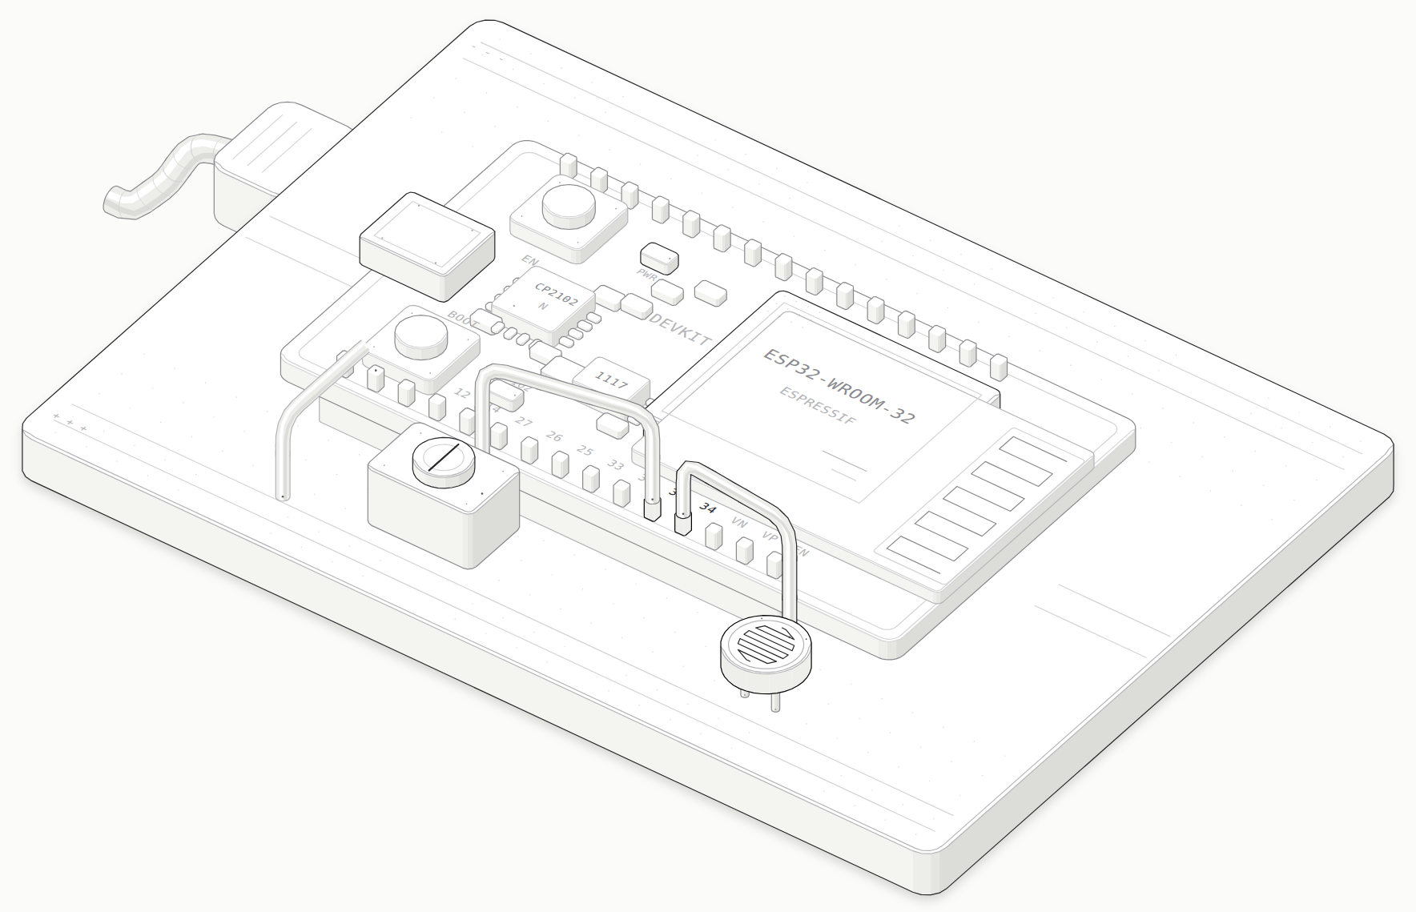
EL Phase-II | Tools and Techniques
Technique: Simulator and ESP32 Model
Deterministic simulator, same JSONL frames
Seeded defect (disclosed) | Trigger | Effect
A: scheduling contention | interval <= 15 ms, load >= 65 | Queuing delay, jitter
B: POT ADC stalls | POT, load >= 50, deadline <= 10 ms | Late completion
C: watchdog starvation | interval <= 5 ms, load >= 90 | Reset, new boot_id
Fault-injection switches
forced watchdog reset, forced comm timeout, forced sensor glitch, corrupted firmware summary
Planner never reads the defect rules. Simulation validates the pipeline, not the physical firmware; simulated and hardware results are never pooled.
ESP32-WROOM-32 DevKit model: shielded module with PCB antenna, USB bridge, regulator, EN/BOOT, GPIO34/35 pins
Switching to the real board is a device-configuration change (mode: serial), not a code change.

Slide 21
EL Phase-II | Tools and Techniques
Hardware and Quality Tools
Tools and Technologies
ESP32-WROOM-32 DevKit: device under test, with an LDR on GPIO34 and a trimmer on GPIO35 read by the 12-bit ADC.
ESP32-S3, RP2040 and programmable rails: long-term multi-rail rig with E-stop and fuse for voltage experiments.
unittest and tsc: 468 passing tests plus a TypeScript type check cover contracts, oracle, planners and Console.
Techniques
Fault injection: forced watchdog reset, comm timeout, sensor glitch and corrupted firmware summary test every failure path.
PC-side recomputation: all statistics are recomputed from raw samples; the PC value is authoritative over the firmware summary.
Boundary tests: enforce layering: model and decision layers import no bench code, so unsafe execution paths are blocked.
Benchmark with Wilson intervals: 500 simulated campaigns, 20 per planner and profile, reported with 95% intervals.

Slide 22
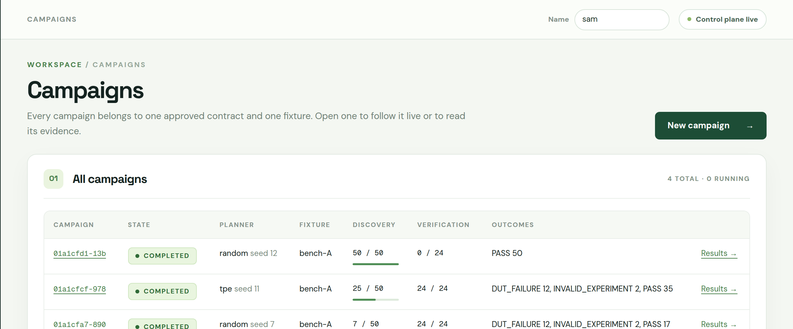
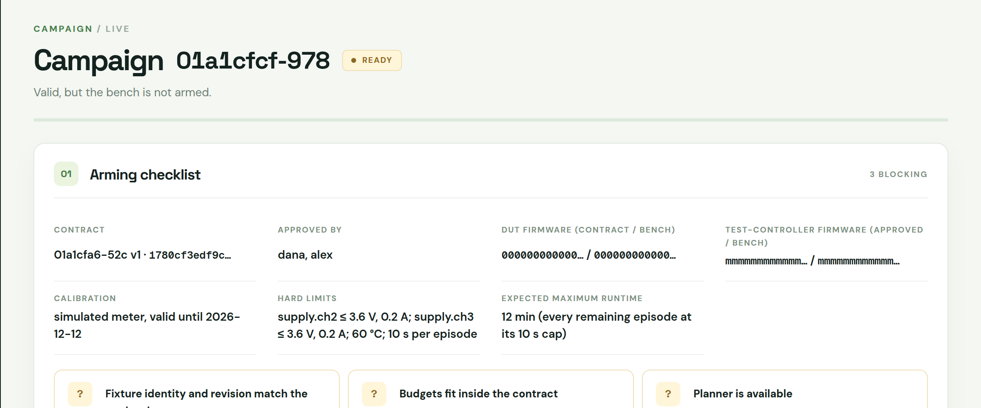
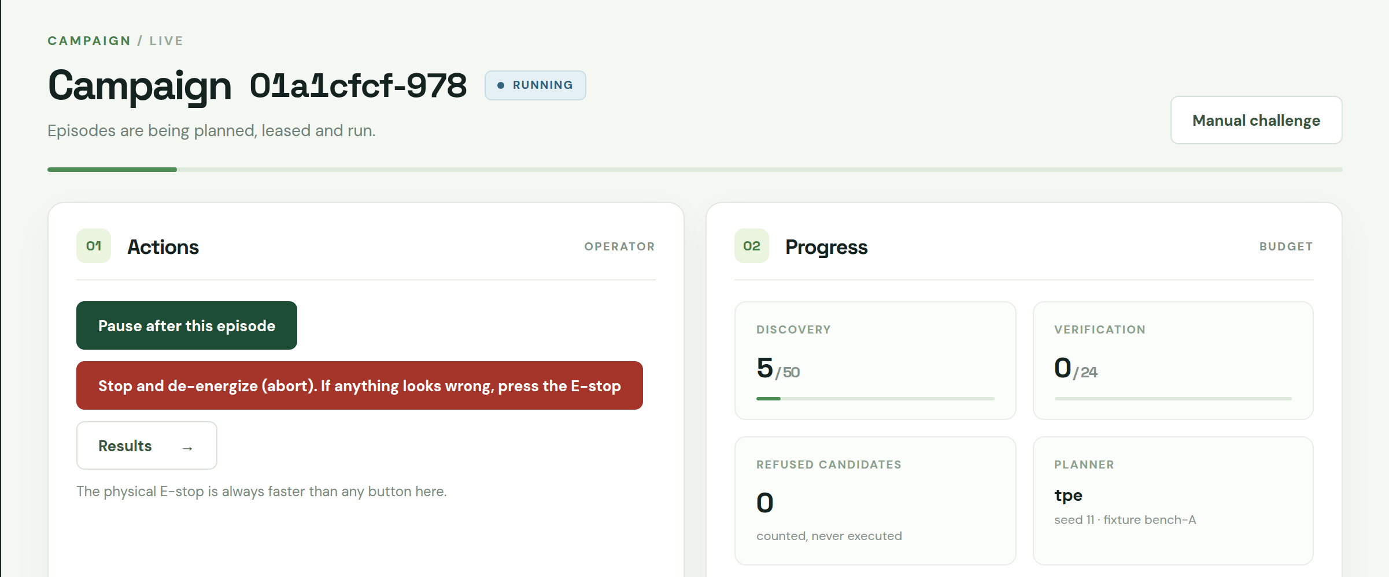
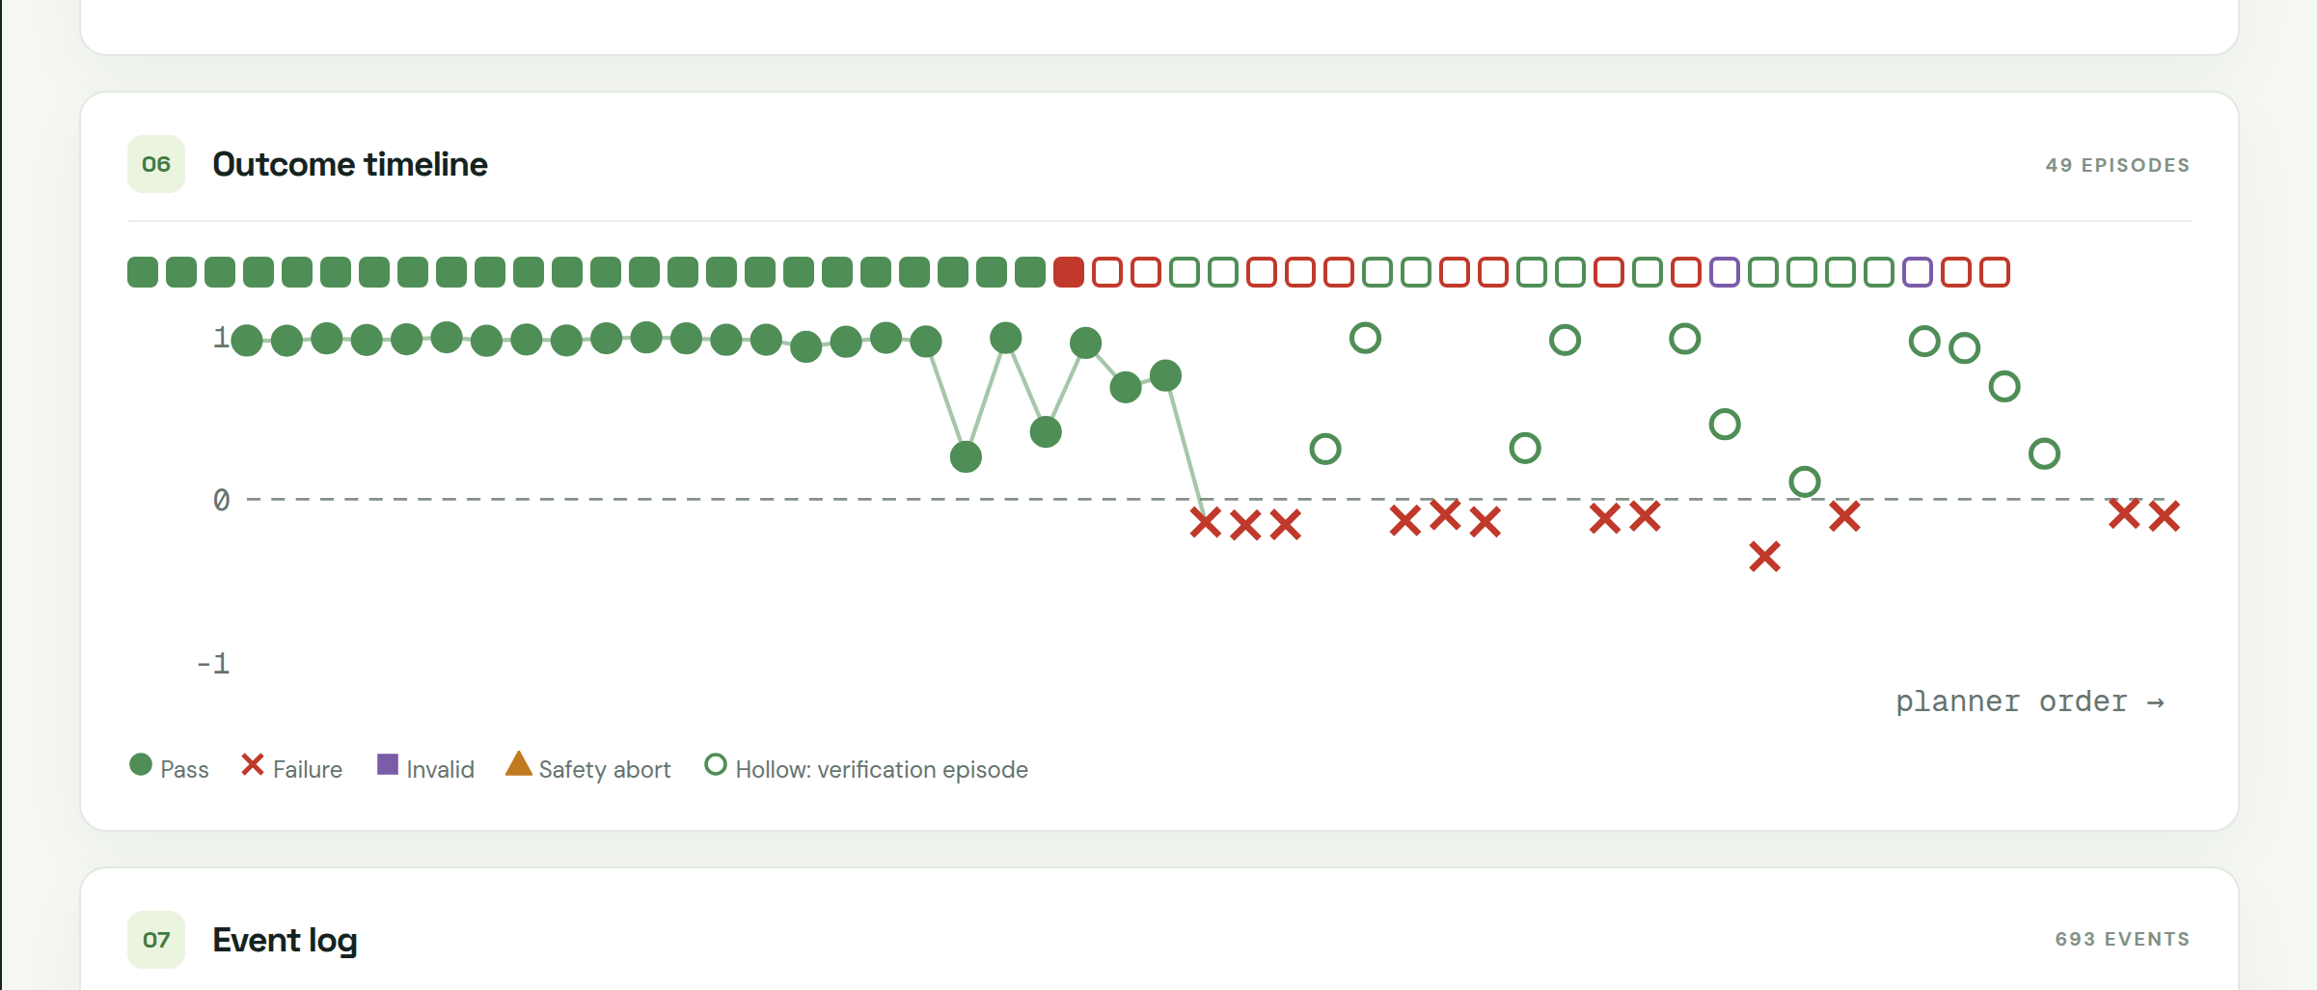
EL Phase-II | Partial Results
Partial Results: Website Screenshots (1)
Campaign list: four finished campaigns on one contract and fixture
Arming checklist: every check must pass before a campaign can start
Live view: budget progress, current episode, bench health, E-stop and watchdog
Outcome timeline of a finished TPE campaign (passes, failures, verification episodes)
468 tests passing | 500 simulated benchmark campaigns | 4 Console campaigns finished | 0 unsafe executions
Notes:
Screenshots of the ChipCheck Research Console running the OLED demo on the simulated bench with dummy data, 13 November 2026.

Slide 23
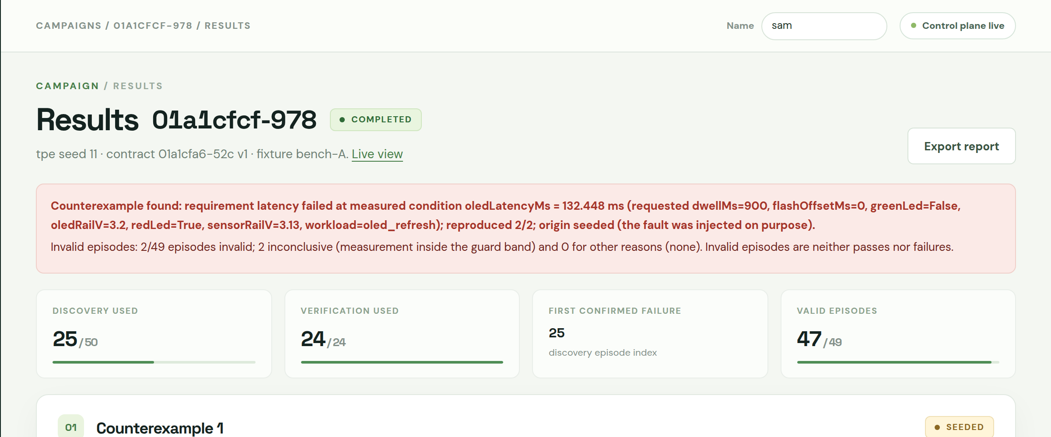
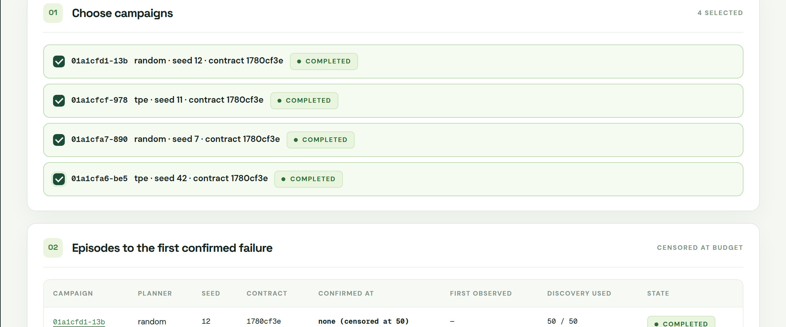
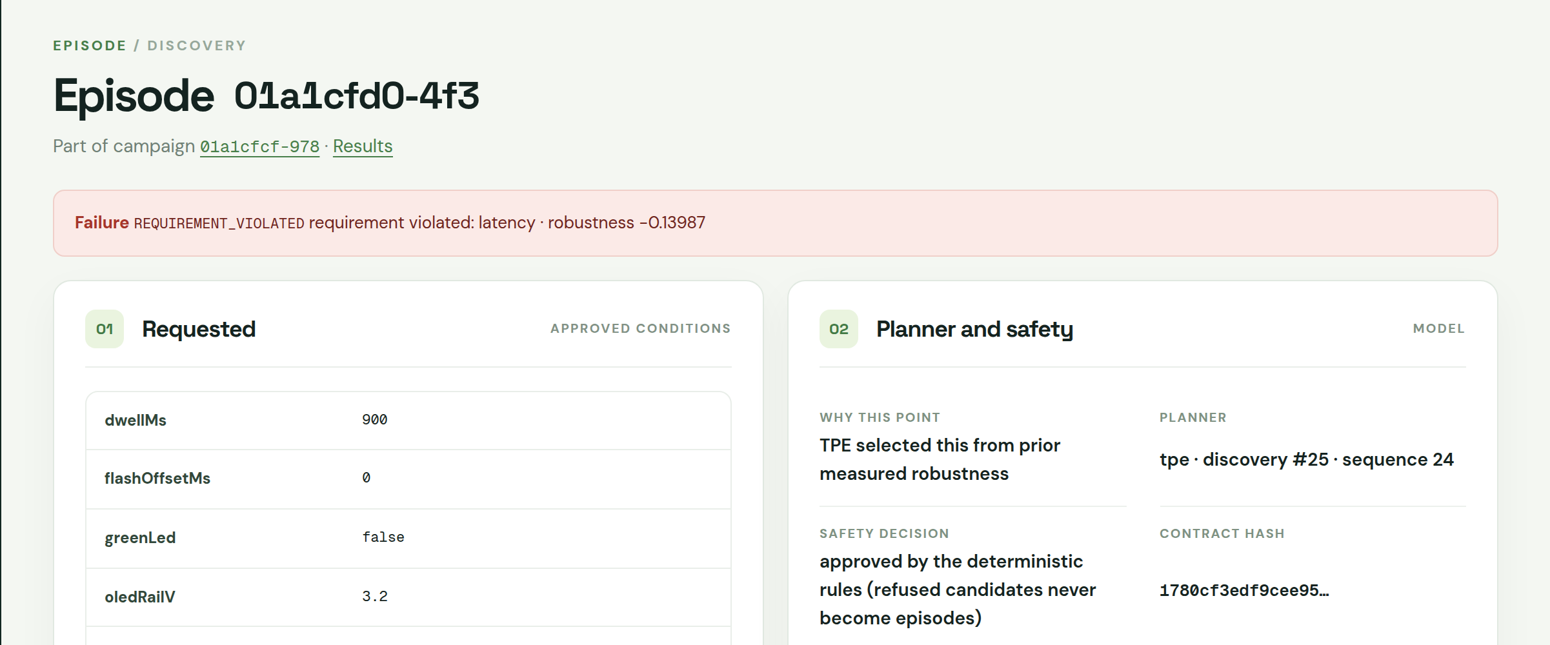
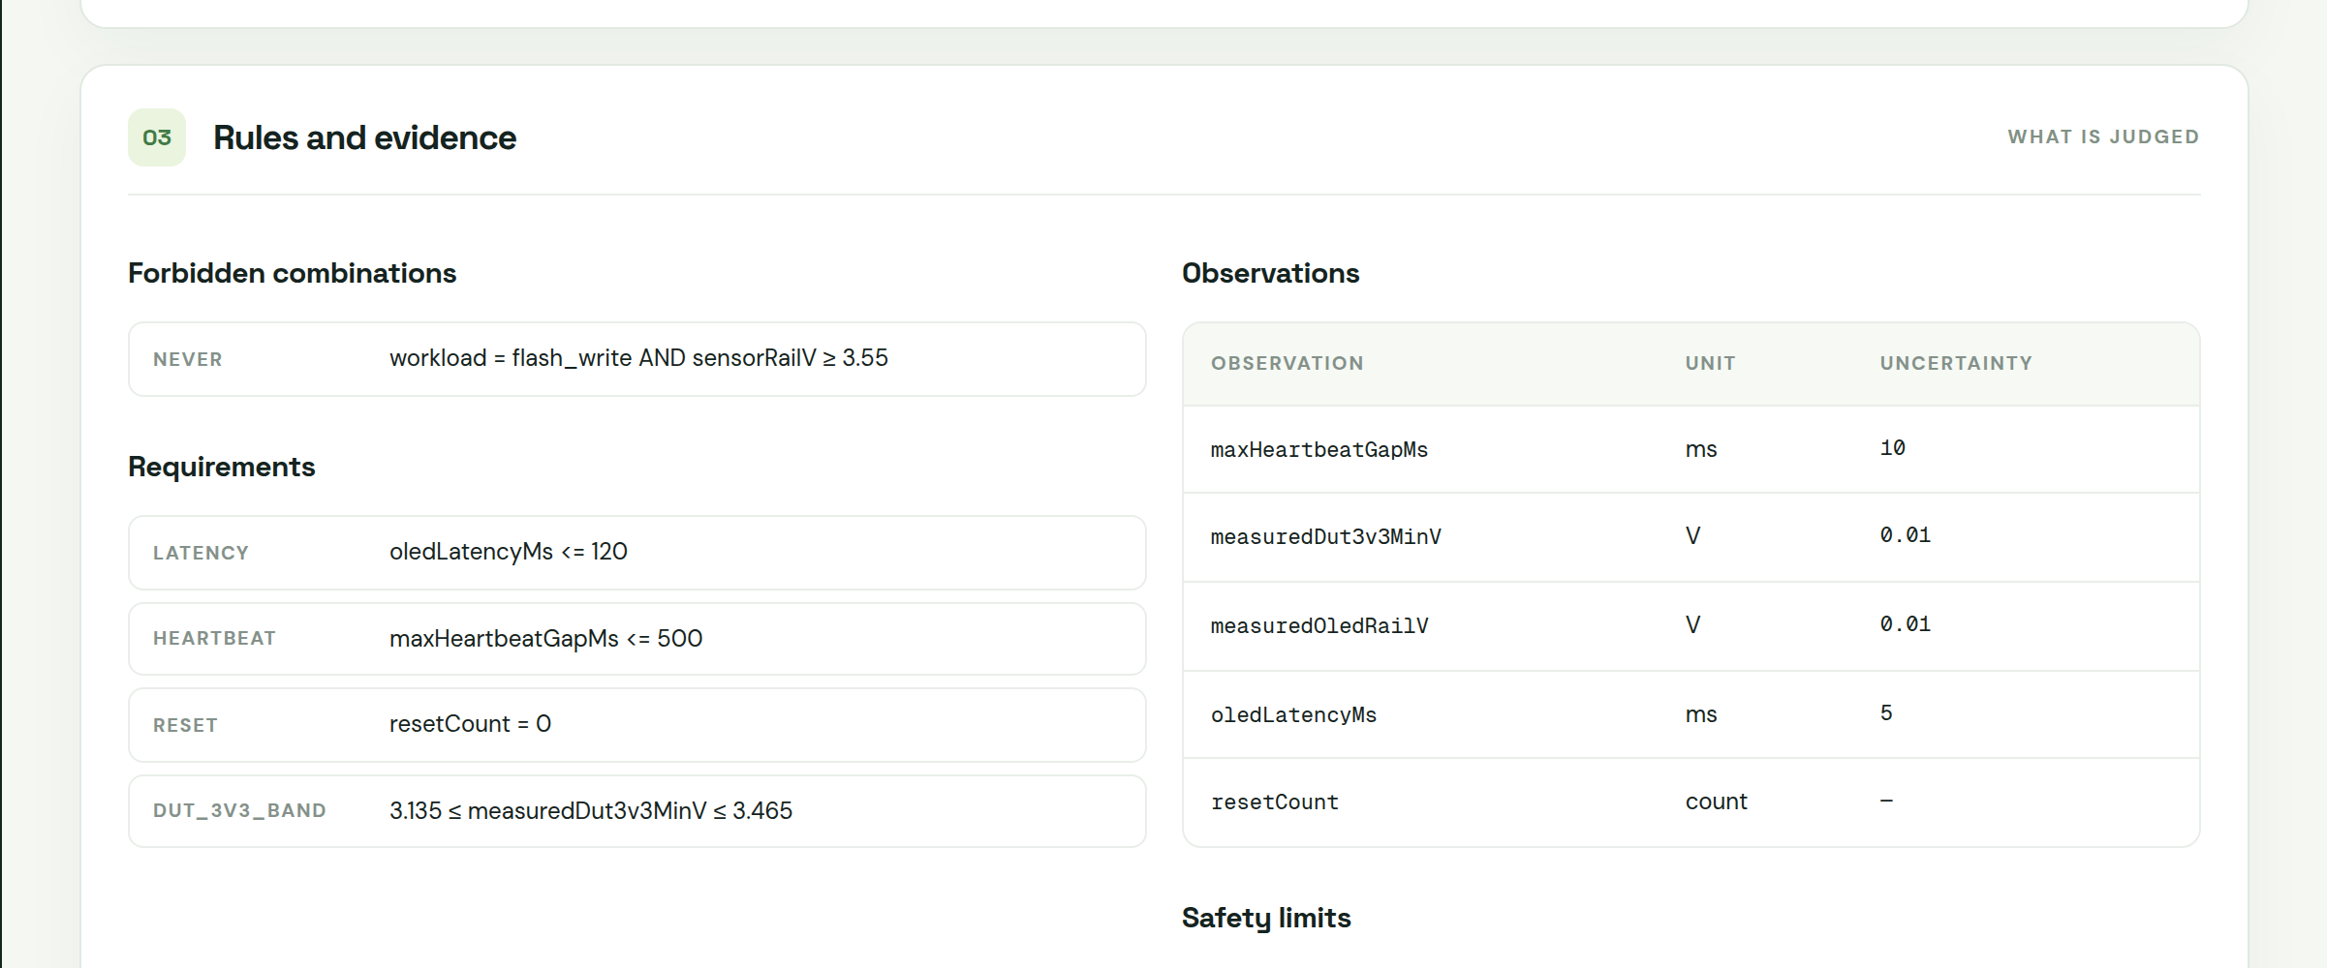
EL Phase-II | Partial Results
Partial Results: Website Screenshots (2)
Results: counterexample reproduced 2 of 2, original and minimised conditions (seeded failure)
Compare: episodes to first confirmed failure, censored at the budget
Failing episode: requested conditions, planner and safety decision, measured values
Approved contract: requirements, observations with uncertainty, hard safety limits
Simulated benchmark: TPE found a failure within 50 experiments in 100% of campaigns on B1w (random 60%) and 85% on B1a (random 10%)
Notes:
Benchmark: python -m activequal.tools.benchmark --campaigns 20 (budget 50, seed 42). 20 campaigns per cell; intervals are wide. Simulated results.

Slide 24
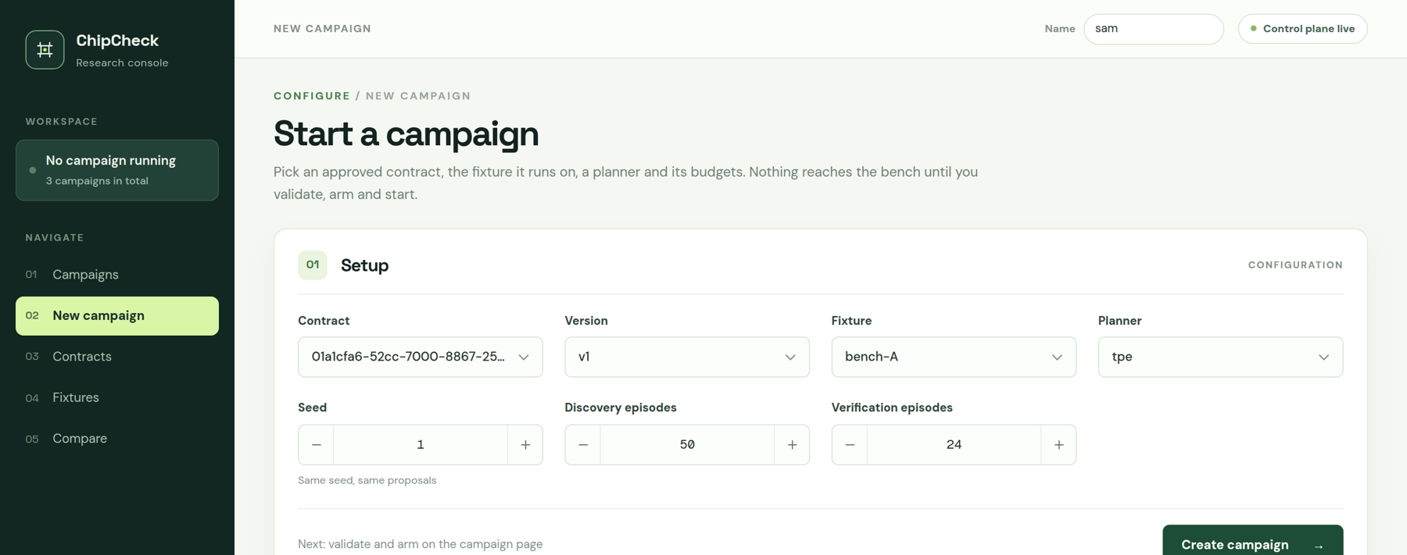
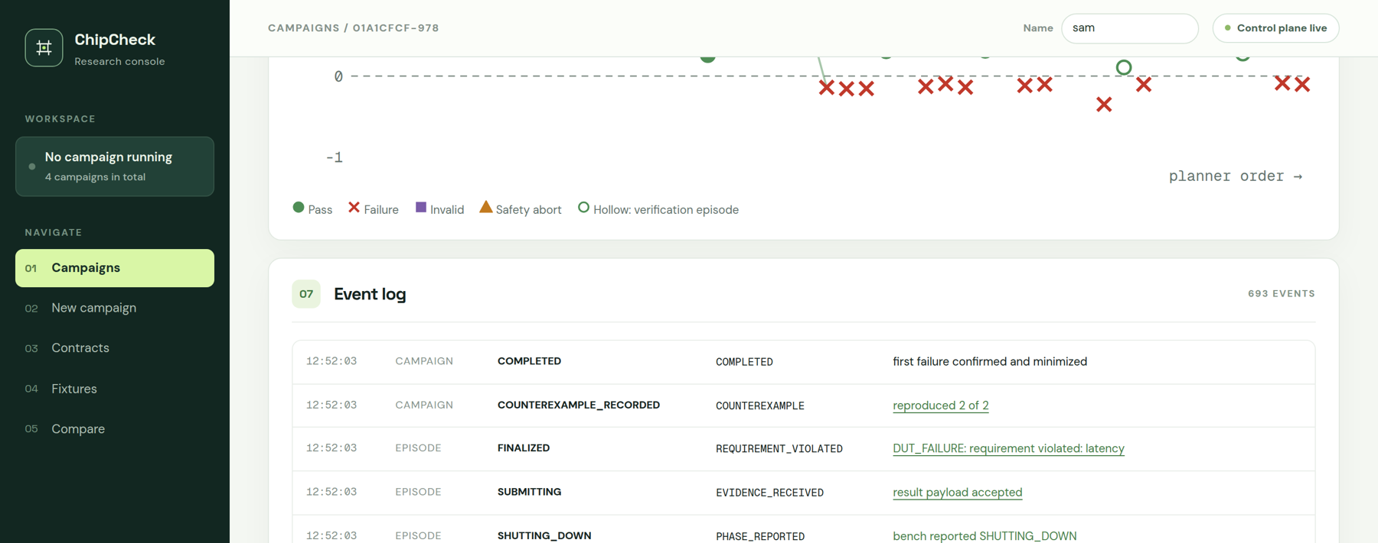
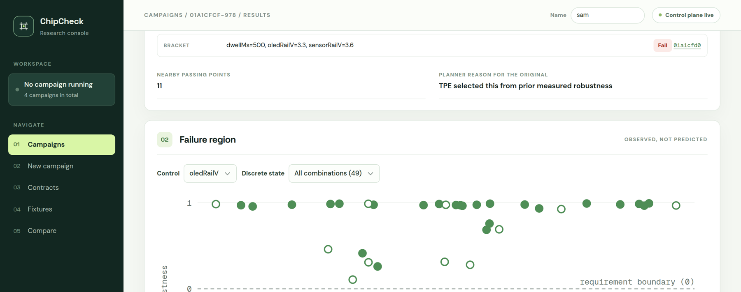
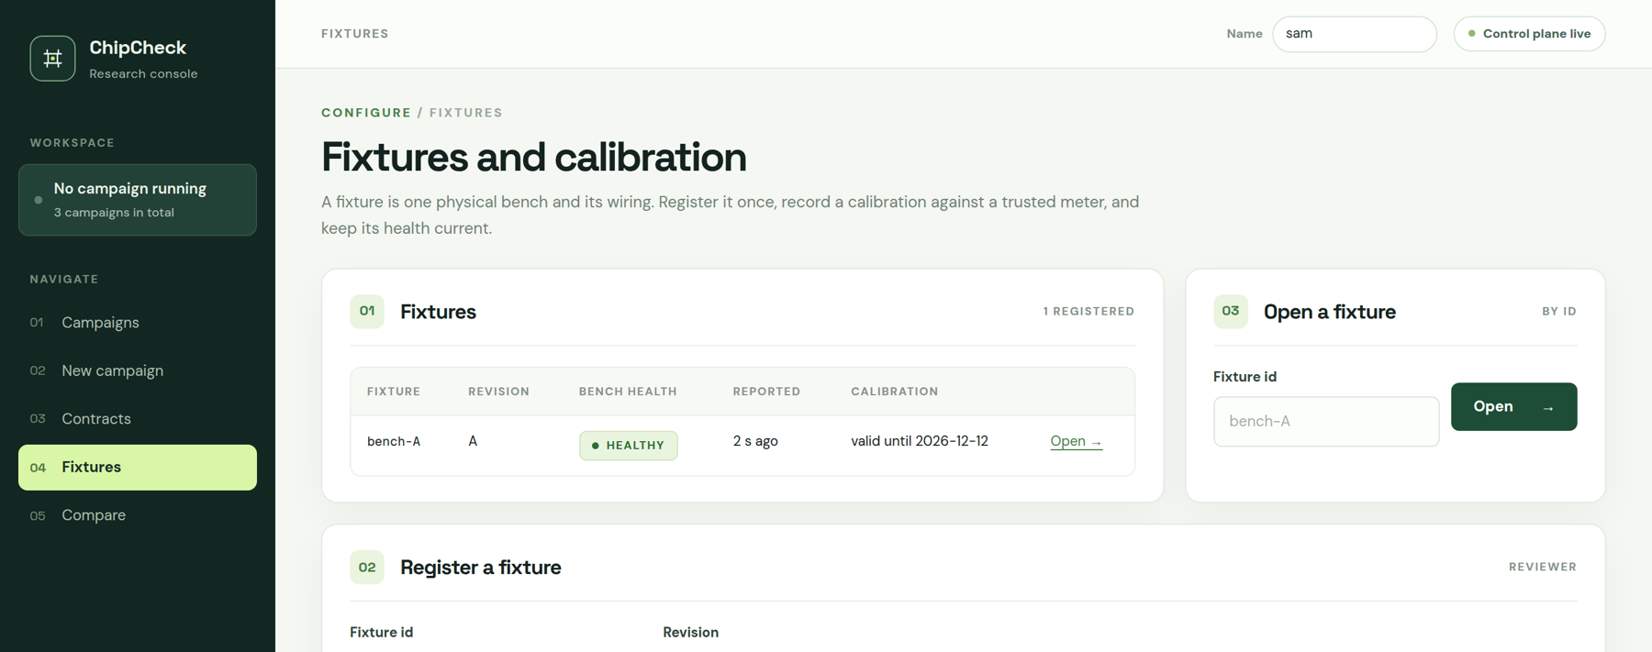
EL Phase-II | Partial Results
Partial Results: Website Screenshots (3)
New campaign: pick contract, fixture, planner and experiment budget
Campaign event log: append-only record of every decision
Verification steps: reproduction and minimisation of the failure
Fixtures: calibrated bench setups each result is tied to
All screens: ChipCheck Research Console on the simulated OLED demo bench, dummy data, 13 November 2026

Slide 25
EL Phase-II | Partial Results
Partial Results: Planner Benchmark
What the numbers say
TPE reached a failure in 100% of campaigns on B1w, against 60% for random
85% on B1a and 80% on B1b, against 10% and 30% for random
B2 (cliff with no precursor): no method beats random; honest tie
B3 has no fault: 0 of 20 campaigns reported a failure for every planner, so no false alarms
Fixed-corner testing found nothing on any profile
Simulator, 20 campaigns per cell, budget 50, seed 42, latency noise 2.5 ms. B1a/B1b: gradient island near 3.25 V (precursor partly / only in target LED state); B1w: wider island; B2: reset cliff, no precursor; B3: no fault.
Notes:
Source: python -m activequal.tools.benchmark --campaigns 20 (13 Nov 2026). Found-within-50 rates: TPE 85/80/100/15/0, random 10/30/60/15/0, grid 20/25/55/40/0, coverage 35/45/80/25/0. Wilson 95% intervals are wide at n=20 (for example TPE on B1w 83.9-100). Research numbers on hardware go through the full stack.

Slide 26
Thank you

